Slide 1
TRAFFICKING IN WOMEN AND CHILDREN : A GLOBAL HUMAN RIGHTS CRISIS
Prof. Aurora Javate de Dios
WOMEN AND GENDER INSTITUTE –MIRIAM COLLEGE

Slide 2
Introduction
Trafficking is one form of violence against women and children capitalizing on the economic, political and social marginalization of women
It is a profoundly gendered phenomenon that is perpetrated by patriarchal structures, cultural practices, and socio-economic inequalities
It constitutes a massive violation of human rights that needs to be addressed collectively by governments and NGOs
Human trafficking occurs within countries as well as across national boundaries and is considered to be one of the most lucrative forms of organized crime with approximately $US 25-31 billion profits a year
All countries are affected by trafficking either as sending, transit or receiving country

Slide 3
A
DEVELOPMENT PROBLEM
A HUMAN RIGHTS PROBLEM
Human Trafficking is a multi-dimensional problem that has negative impacts on individuals, communities and societies
A
LABOR PROBLEM
A
GENDER PROBLEM
Human Security problem
A MIGRATION PROBLEM
Notes:
Link this slide to the 4 categories of intervention and the need to adopt a multi-sectoral approach which needs to be fully coordinated. Effective coordination will come from a policy that institutionalizes such an approach.

Slide 4
Scale and Magnitude
Human trafficking - second most profitable illicit trade, after drugs
-Generates about US$ 217 billion in revenue, annually*, - linked to other organized crimes - human smuggling, drug trafficking, and money laundering
-ILO - there are 2.45 million trafficking victims currently under exploitative conditions - estimated that another 1.2 million persons are trafficked annually ;
-UNODC estimates that 71 percent of detected trafficking victims are women and girls.
-Of these, 72 percent are trafficked for purposes of sexual exploitation and the exploitation of prostitution.

Slide 5
Features of modern day slavery
Outstrips the old system of slavery in volume, reach and profitability;
Facilitated by globalization processes such as migration of peoples, new information technologies , mass transportation and the integration of the sex industry into mainstream economies and the use of cheap , irregular and slave like like labor in capitalist economic activities;
Earning an estimated $ US 31 billion a year, trafficking is controlled by several layers of intermediaries mostly organized crime and syndicates as well as local recruiters and community operators preying on victims ;

Slide 6
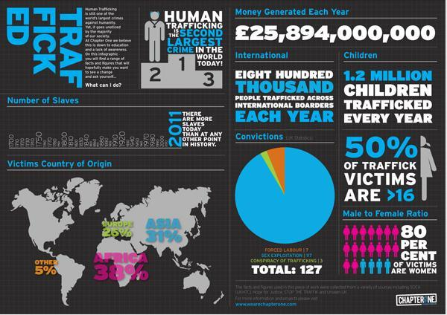

Slide 7
Definition of Human Trafficking (ArticLe 3, UN OPTIONAL PROTOCOL ON TRAFFICKING )

Slide 8
Trends in trafficking of women and children
1)Diverse and sophisticated methods of recruitment utilizing local and community networks linked with trafficking networks;
2)More and more children and young adults are targeted for recruitment for sexual exploitation;
3)Widespread culture of sexual consumerism fueled by extensive use of new and cutting edge information technologies by the sex industry;

Slide 9
TRENDS IN ASEAN REGION
Nearly 1/3 of the global trafficking trade are from the Southeast Asian region about 60% to major regional cities and about 40% to the rest of the world;
Indonesia- Cases of trafficking to the Gulf countries , Malaysia, Taiwan , US and New Zealand. Internal trafficking of women in mining operations in Maluku , Papua and Jambi and in Batam district. UMRAH or Haj has also been used to trafficked women. According to the TIP Report , 2011 forced labor of Indonesians were found aboard Korean flagged ships .
Vietnam on the other hand ,had been the source of internationally brokered marriages in China, Macau, Taiwan, South Korea and are sometimes subjected to forced labor or prostitution or both.

Slide 10
TRENDS IN ASEAN REGION
Thailand – hub for sex trafficking of women and children coming from Burma, Cambodia and Laos catering to locals and foreign tourists. Tourism is worth $ 11 billion in Thailand Men in turn are trafficked for cheap labor in commercial fishing, low end garment manufacturing and begging;
Cambodia -because of the massive inroads of peacekeepers in the 80s, Cambodia became a center for sexual exploitation of women and children and was one time known as the haven of pedophiles with the highest incidence of HIV AIDS in the region;
Philippines prosecuted over 100 traffickers (internal and international over the last 7 years. There is trafficking internally in major cities as well as in many countries like Malaysia , Singapore, Hongkong , Japan , Korea for sexual exploitation . Cyber pornography rings proliferate in the provinces

Slide 11
The Root Causes of Trafficking
Patriarchal attitudes and behavior that degrade women in all cultures ;
The normalization and commercialization of the sex industry via trimedia –new information technologies that promote pornography and prostitution culture across generations -
Globalization processes on less developed countries that aggravate widespread poverty in the developing countries. Class and gender inequalities ; discrimination and gender-based violence
Poverty ;lack of economic opportunities for women ; political instability, conflicts and civil unrest , displacement due to natural disasters and adverse environmental conditions are compelling factors that drive people to migrate and seek better options in other countries.

Slide 12
Understanding Demand as a Driver of Sex Trafficking
Sex trafficking would not exist without the demand for commercial sex flourishing around the world…… Where prostitution is tolerated , there is greater demand for human trafficking victims and nearly always an increase in the number of women and girls trafficked into commercial sex.” Trafficking in Persons Report, 2007. Washington: State Department;
Who Constitutes the Demand ?
Businessmen; professionals; transport workers; seafarers; military and peace keeping forces; transient and migrant workers; young men ; ordinary men -both married and single- create the market for sex
"The economic reality is that human trafficking is driven by profits. If nobody paid for sex, sex trafficking would not exist”
Buyers provide the economic incentive for international sex trafficking

Slide 13
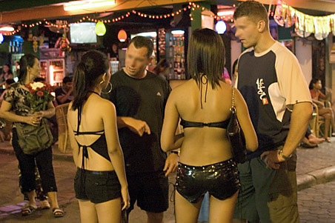
Trafficked women and girls are in demand in military bases in Korea

Slide 14
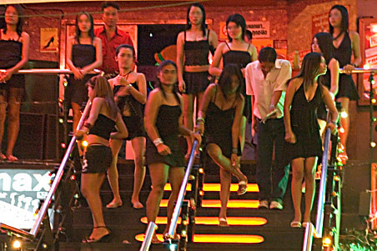
A typical destination of trafficked women: Bars for male entertainment in Bangkok

Slide 15
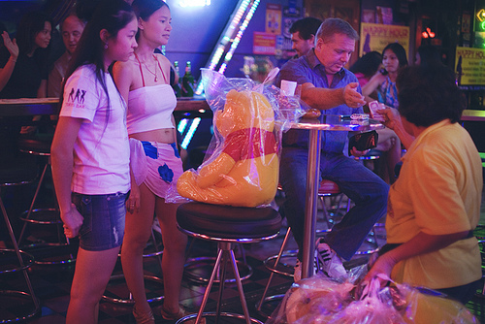
Sex Tourism-
The reverse of sex trafficking and part of the trafficking chain-- sex tourism increases demand.
Sex tourists including soldiers, businessmen and young men travel to developing countries, primarily in the global South and East.

Slide 16
The Business of Sex
Every Second:
28,258 users are watching pornography on the internet.
$3,075.64 is being spent on pornography on the internet.
372 people are typing the word "adult" into a search engine.
Every Day:
37 pornographic videos are created in the United States.
2.5 billion emails containing porn are sent or received.
68 million search queries related to pornography- 25% of total searches- are generated.
116,000 queries related to child pornography are received.
The porn industry’s net worth is about $97 billion.
13,000 films and close to $15 billion in profit. The porn industry makes more money than Major League Baseball, The NFL and The NBA combined.
Porn Sites get more visitors each month than Netflix, Amazon and Twitter combined. In fact, XVideo, on its own, is bigger than Dropbox, CNN and New York Times combined

Slide 17
Sexual Trafficking Through Cyberspace
Type of Illegal Activity Seller/Supply (Uploaded Here)
Trafficking
Sex Trafficking (Private Chat Lines)
Encryptation Remailers
(to ensure and maintain secrecy)
Child Pornography & Violent Pornography
Consumer/ Demand
(Downloaded Here)
Child and Woman Stalking –sexting; internet
Adult Pornography
Libraries
Schools
Offices, Hotels, Business Establishments
Internet cafes
Homes

Slide 18
Long Term Impact of the Culture of Pornography
Pornography reinforces the negative stereotypes of men (as obsessively sexual) and women (as sexual objects ) ; promotes male sexual aggression and violence against women ;
Pornography hurts adults, children, couples, families, and society.
Among adolescents, pornography hinders the development of a healthy sexuality, and among adults, it distorts sexual attitudes and social realities. In families, pornography use leads to marital dissatisfaction, infidelity, separation, and divorce.”
40 percent of people identified as “sex addicts” lose their spouses, 58 percent suffer considerable financial losses, and about 33% lose their jobs.^{( American} Psychological Association )

Slide 19
Pornographic content of phone texting among teenagers, shows that the digital revolution is being used by younger and younger children to dismantle the barriers that channel sexuality into family life.
It increases the odds of teenage pregnancy. Teenagers with frequent exposure to sexual content on TV have a substantially greater likelihood of teenage pregnancy
It hinders sexual development. Pornography viewing by teens disorients them during the developmental phase when they have to learn how to handle their sexuality and when they are most vulnerable to uncertainty about their sexual beliefs and moral values.ix ( American Psychological Association)

Slide 20
Consequences of Trafficking for Sexual Exploitation
The Harms of Prostitution
and Trafficking
HEALTH HAZARDS
STDS
PID
VD
HIV AIDS
Infertility
PHYSICAL HAZARDS
Physical Violence
Battery
Assault/Rape
Forced Drugging
Kidnapping
Unwanted Pregnancy
Drug Addiction
PSYCHOLOGICAL HAZARDS
Mind/Body Separation
Disembodiment
Hatred of Men
distrust
Emotional Impairment
Loss of Childhood
Drug Addiction
SOCIAL PROBLEMS
Discrimination
Alienation
Marginalization
Ostracism
Drug Addiction
Children
Particularly vulnerable

Slide 21
Significant Progress in Combatting Trafficking in Persons
International Law – UN Optional Protocol on Trafficking: Guidelines and Principles on Trafficking of Persons;
Strong regional trafficking legal instruments – EU, ASEAN, SAARC etc
National Legislation against Trafficking
Resolution adopted by the General Assembly on 30 July 2010 United Nations Global Plan of Action to Combat ;
Research, analysis and monitoring of trafficking situation UN-OHCR

Slide 22
What Can Be Done ? Interdependent Approaches to Combating Trafficking
Sexual Exploitation
PREVENTION
PROSECUTION
/ LEGISLATION
Assistance to Victims
-Public education and campaigns against trafficking in vulnerable areas esp. in urban poor and rural poor communities ;
-Poverty alleviation and social emergency programs (jobs)
-Multilateral and bilateral agreements to prevent sexual exploitation and trafficking;
-Radio, TV and social media spots against trafficking ;
-Educating Men and Girls about respectful gender relations and sexuality ;
-Responsible Use of New Information Technologies
Crisis Services for Victims
Victim centere assistance programs
Psychological counseling Shelters for trafficked women
Drug rehab
Comprehensive health services and health care
No criminalization and deportation
Empowering victims thru self-help and survivor-leadership training
Ratification of UN Optional Protocol on Trafficking
Laws that clearly and specifically penalize sexual exploitation
Laws that follow traffickers and sexual exploiters across borders
Enforcement of laws against sexual offenders
Phil Anti-Trafficking Law

Slide 23
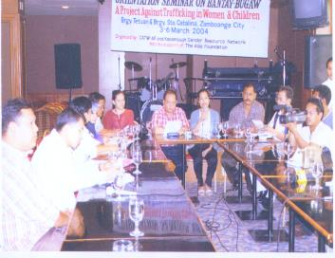
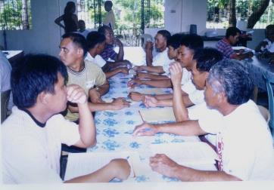
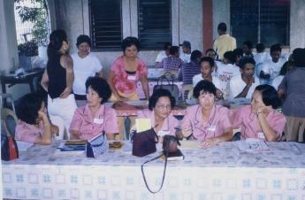
Community –Based Prevention Programs
Trafficker/Pimp-Watch Project in Calbayog, Zamboanga City and Quezon City (CATW –AP); Marawi and the conflict affected communities in Bangsa Moro areas
Conduct of education in high-risk communities addressing local government agencies, village officials, teachers and other community leaders on trafficking and laws/mechanisms

Slide 24
Innovative Strategies to End Trafficking of Persons
LISTEN TO THE VOICES OF SURVIVORS OF TRAFFICKING
When I look back now I see that prostitution lured and consumed those of us who were already marginalised in society. If you were poor, if you were disadvantaged, if you had come from a broken home or had vulnerabilities connected to prior cycles of abuse, especially sexual abuse, prostitution was there waiting for you. Prostitution is a trap, and it’s not a coincidence that all over the world it ensnares those who are already struggling to survive.“
Rachel Moran, Dublin, Ireland, Survivor Leader, President of SPACE International
"What I know today is that women are victimised by the system of prostitution by innumerable perpetrators, and at the same time victimised by a society which is not only allowing but encouraging prostitution by accepting it as a 'job like any other'. We are victims of a society blind in one eye, advancing the wealth of a privileged few over the suffering of an incalculable number of women and children."
Marie Merklinger, Stuttgart, Germany
“ I was trafficked to Singapore where I ended up as a prostitute. We were very poor so going abroad was a good opportunity to improve our lives. I am grateful to have a second chance and to finish my highschool.I want to take up accounting so I can help victims like me to have a livelihood program and out of prostitution”. (Linda (not her real name )
Survivor of trafficking graduated with the highest honors in a night school in the Philippines)

Slide 25
Reject Toxic masculinity
Toxic masculinity transcends national borders, age, generations, and ideas of race and ethnicity. Men are overwhelmingly both the perpetrators as well as the victims of violence. This is because notions of masculinity, and what it means to be a man, seem to be the driving factor behind much of the risky behavior that males engage in.

Slide 26
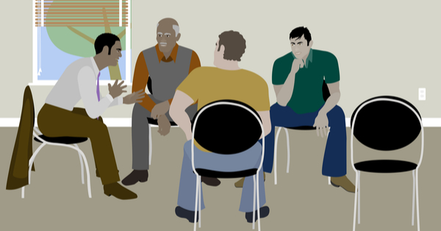
Promote Positive Masculinity

Slide 27
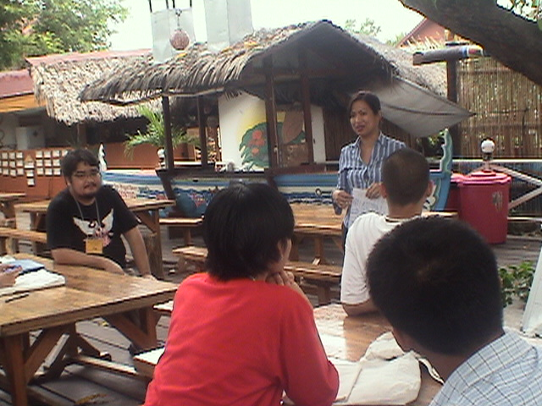
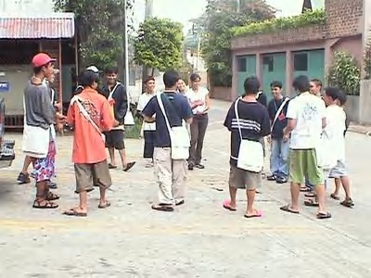
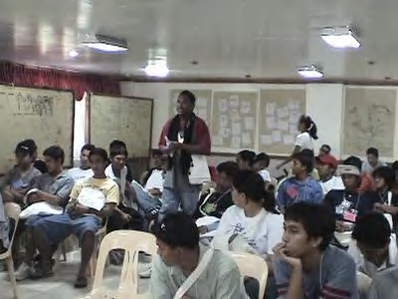
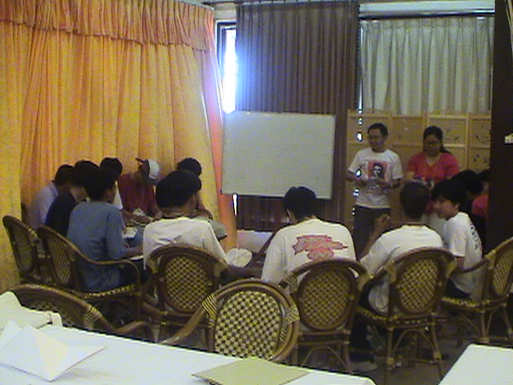
Young Men’s Camp on Gender Issues , Sexuality , Trafficking and Prostitution

Slide 28
Ways Forward
More effective coordination and sustained capability building and training of national officers as well as regional and trans boundary cooperation with police and immigration officials bilaterally or multilaterally;
Community Based Prevention as well as trans boundary police and immigration officials . Such training must be rights based and gender and child sensitive;
Development of More Survivor Leadership Programs ;
Community based Prevention Programs ; working with the Youth and the Private Sector
Strengthening Bilateral, Regional and International Cooperation thru MOAs; agreements and treaties ;
Addressing the Demand Side of Trafficking by Promoting Positive Masculinities

